Slide 1

Reference ID: INC25ETN082650
Theme: Low-Carbon footprint solutions / technologies
Project Title: FireNet Sentinel Pods – An IoT-Based Forest Fire Detection and First Response System
MSME Idea Hackathon 5.0
Smart and Sustainable MSMEs
Name: Priyavarshini V
Designation: B.E. CSE(AI&ML) - 2nd Year Student Organization: Sri Eshwar College of Engineering Location: Coimbatore
18-08-2025
MSME Hackathon 5.0 - SECE
1

Slide 2
Problem Statement
India loses millions of hectares of forest to fires every year, causing biodiversity loss, livelihood damage, and large CO₂ emissions.
Existing monitoring (satellites, drones, manual watchtowers) is delayed, expensive, or inefficient.
Response time is too slow, leading to uncontrolled spread.
Forest fires are frequent, devastating, and current detection fail in speed, cost, and accessibility.
Theme
methods
Hackathon Theme: Low-carbon footprint solutions/technologies
Forest fire prevention = reduction in CO₂ emissions, ecosystem loss, and economic damage.
Aligns with India’s Net Zero 2070 Vision.
FireNet directly supports carbon footprint reduction.
MSME Hackathon 5.0 - SECE
2
18-08-2025

Slide 3
Market Size and Statistics
The Global Wildfire Management Market was valued at $9.4 billion in 2023 and is projected to reach $17.1 billion by 2032, growing at a CAGR of ~7%.
According to the Forest Survey of India (FSI), 3.4 million hectares of
forest land are affected annually, with over 50% of India’s forests vulnerable to fire.
Economic losses caused by wildfires amount to more than $30
billion globally every year.
Rising climate change effects are increasing the frequency, intensity, and spread of forest fires, further enlarging the market opportunity for cost-effective, community-driven solutions.
18-08-2025
MSME Hackathon 5.0 - SECE
3

Slide 4
Gap Analyzed with Existing Solutions
Satellite Monitoring: Provides large-scale coverage but suffers from detection delays (fires identified only after significant spread).
Drone Surveillance: High precision but expensive, requires skilled operators, and cannot cover wide areas continuously.
Manual Watchtowers/Patrols: Low-cost but inefficient, human- dependent, and prone to late reporting.
Aerial Firefighting (water bombing/chemicals): Effective only at later stages, extremely costly, and logistically complex.
Gap Identified:
There is no low-cost, decentralized, first-response solution that enables both early detection and immediate localized suppression of fires before they escalate into disasters.
18-08-2025 MSME Hackathon 5.0 - SECE
4

Slide 5
Proposed Solution
FireNet Sentinel Pods is a two-stage first response system:
Stage 1 – Detection Pods
Solar-powered IoT devices equipped with sensors for smoke, heat, CO₂, and gas anomalies.
Edge AI validates abnormal readings to reduce false alarms.
Real-time alerts sent via GSM/LoRa to forest rangers, fire departments, and local villagers.
Stage 2 – Suppression Pods (Future Upgrade)
Compact suppression units with water mist sprayers, sand release, or bio-gel based retardants.
Auto-activated when early flames or sparks are detected. Provides localized containment before the fire spreads.
Core Idea: Low-cost, self-sustained pods deployed in mesh networks across forests to act as community-driven fire guardians.
5
18-08-2025 MSME Hackathon 5.0 - SECE

Slide 6
Sustainable Development Goals (SDG)
Sustainable Development Goals (SDGs) Impact SDG 13 – Climate Action
SDG 15 – Life on Land
SDG 9 – Industry, Innovation & Infrastructure SDG 11 – Sustainable Cities & Communities
Technology Readiness Level (TRL)
Detection Pods: TRL 5–6 (validated prototype ready for small- scale field deployment).
Suppression Pods: TRL 3–4 (conceptual design stage; to be developed with pilot testing).
18-08-2025
MSME Hackathon 5.0 - SECE
6

Slide 7
Prototype
Concept Design:
FireNet Sentinel Pod (solar-powered, IoT-enabled).
Components: smoke/heat/CO₂ sensors, microcontroller, GSM/LoRa module. Future extension: mini water mist/sand/bio-gel suppression unit.
Current Status:
Prototype not physically built yet.
Blueprint and workflow prepared with identified components. Sensors and connectivity modules shortlisted for integration.
Planned Development Roadmap:
Phase 1 – Sensor & microcontroller integration.
Phase 2 – Field testing in controlled environment.
Phase 3 – Add suppression system for incipient fires.
Technology Readiness Level (TRL):
Current: TRL 3–4 (concept + analytical proof-of-concept). Target: TRL 5–6 (prototype validated in relevant environment).
18-08-2025
7
MSME Hackathon 5.0 - SECE

Slide 8
Technology Stack & Workflow
Hardware Components:
Sensors: Smoke, temperature, CO₂, methane, VOCs. Power: Solar panels with low-power batteries.
Communication: GSM/LoRa for alerts.
Software Components:
On-device edge AI for anomaly detection. Cloud/Local dashboards for monitoring alerts. Alert delivery via SMS, mobile app, and sirens.
Workflow:
Sensors detect abnormal rise in smoke/heat.
Edge AI validates the event → reduces false alarms.
Detection pod sends alert → forest guards & villagers notified.
4.(Future) Suppression pod triggers → mist/sand/bio-gel deployed on spot.
5. Data stored in system for fire pattern analytics.
18-08-2025 MSME Hackathon 5.0 - SECE
8

Slide 9
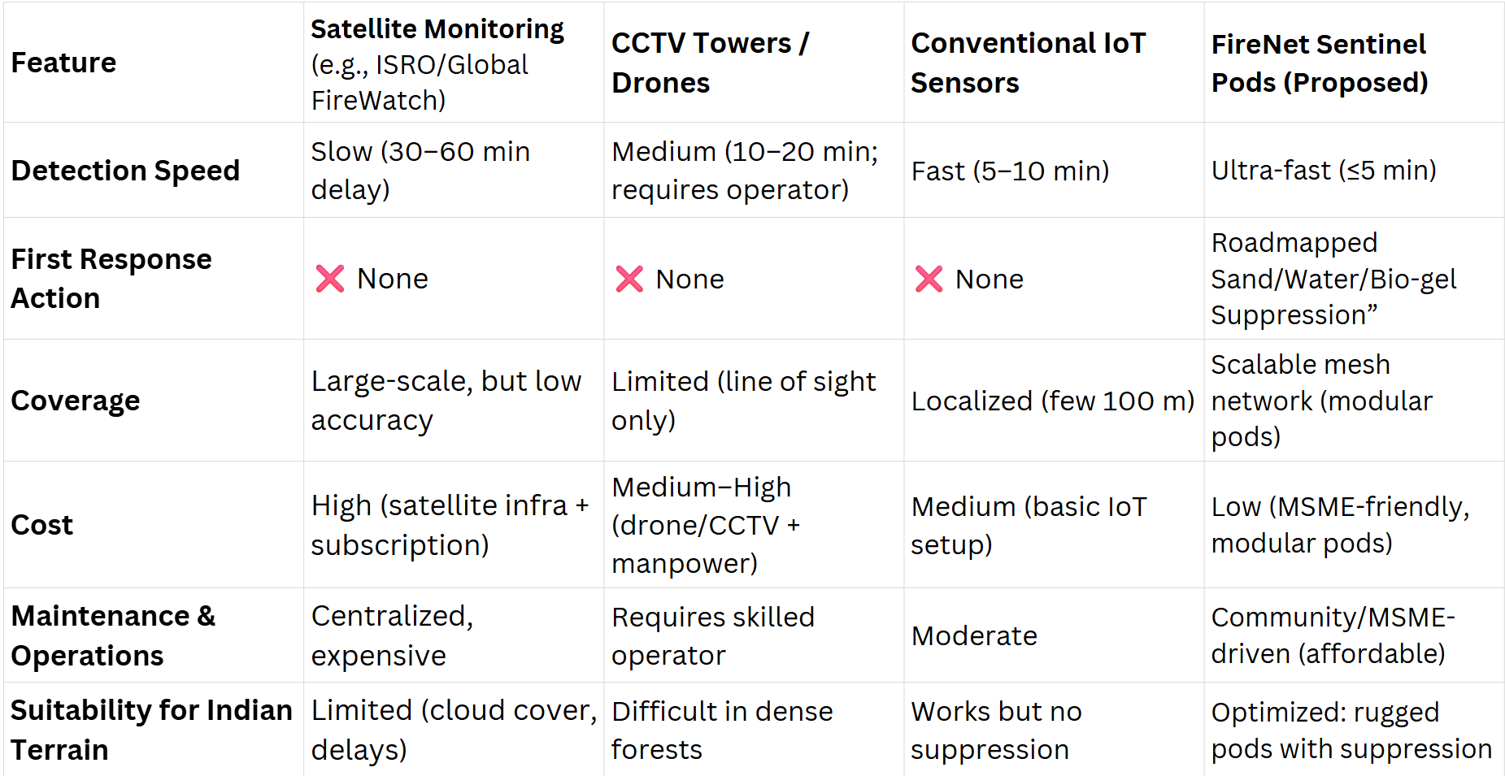
Competitor Analysis
18-08-2025
MSME Hackathon 5.0 - SECE
9

Slide 10
Unique Selling Proposition (USP)
Early Detection + Local Suppression:
Unlike existing systems that only detect, our pods also aim to spray sand / water / bio-gel for initial containment.
Low-Cost, Scalable Pods:
Affordable, solar-powered units that can be widely deployed in rural & forest areas.
Connectivity in Remote Areas:
Works with LoRa/GSM mesh network, ensuring alerts even in no-internet zones.
Eco-Sustainable Approach:
Uses minimal resources (solar energy, localized spraying) with low carbon footprint.
MSME-Centric Manufacturing:
Pods can be assembled and deployed by local MSMEs, creating jobs and rural empowerment.
18-08-2025
MSME Hackathon 5.0 - SECE
10

Slide 11
Business Model
Target Customers:
Forest departments.
Disaster management authorities. NGOs & eco-tourism operators.
Smart city projects & private eco-reserves.
Partnerships:
MSMEs for local manufacturing & deployment.
Governments for large-scale adoption.
Research institutes for AI-fire prediction integration.
Revenue Streams:
Sale of detection pods.
Annual maintenance and service contracts.
Subscription for fire monitoring & environmental data.
Future Scope:
Commercialize suppression pods. Create AI-driven fire prediction dashboards.
Export to wildfire-prone countries.
18-08-2025
MSME Hackathon 5.0 - SECE
11

Slide 12
“Detect early, respond instantly, protect sustainably”
Thank You
18-08-2025
MSME Hackathon 5.0 - SECE
12

